Slide 1
PREDICTIVE ANALYTICS
B.Sc. Data Science Honours | Extra / Accelerated Lectures
BSCDS47(B) | Department of Technology, SPPU
Dr. Aparna Jagtap

Slide 2
Course Map
UNIT I — Simple Regression Analysis — 9 Hours
Concept Fundamentals of Regression Analysis
Requirements in Regression Model Building
Model Diagnostics
Interpretation of Regression Results for Management Decision
Multiple Regression Analysis: Concept
Significance of Multiple Regression Analysis
Structure of Model Estimation
Testing Rule of Multiple Regression Analysis
UNIT I — Simple Regression Analysis
9 Hours
UNIT II — Non-Linear Regression Analysis
9 Hours
UNIT III — Dummy Modelling & Panel Data
9 Hours
UNIT IV — Forecasting & Time Series Forecasting
9 Hours
UNIT V — Data Mining & Simulation
9 Hours
Total teaching scheme: 45 hours

Slide 3

What is Predictive Analytics?
Predictive analytics is a branch of data science that leverages statistical techniques, machine learning algorithms, and historical data to make data-driven predictions about future outcomes.
Why Predictive Analytics is important?
Informed Decision-Making:
Risk Management:
Optimization and Efficiency:
Personalized Experiences:
Innovation and Competitive Advantage:
Core idea: DATA → MODEL → PREDICTION → DECISION
Typical applications: sales forecasting, risk prediction, customer behaviour, healthcare and business decisions.

Slide 4
Four Types of Analytics
Descriptive Analytics : What happened?
Purpose: Summarizes past data to show historical trends and performance.
Common Tools: Dashboards, charts, KPIs, and monthly reports.
Example: Reviewing last month's sales numbers to see which products sold best
2. Diagnostic Analytics: Why did it happen?
Purpose: Investigates the root causes behind trends or unexpected changes.
Common Techniques: Drill-down analysis, data mining, and correlation.
Example: Finding out that a drop in sales was caused by a recent price increase in a specific region.
3. Predictive Analytics: What is likely to happen?
Purpose: Uses historical data and machine learning to forecast future events.
Common Techniques: Statistical modeling, forecasting, and regression.
Example: Estimating next quarter’s revenue based on past seasonal shopping habits.
4. Prescriptive Analytics: What should we do next?
Purpose: Recommends specific, data-driven actions to achieve the best outcome.
Common Techniques: Simulation, algorithms, and automated decision logic.
Example: Suggesting an optimal price point or automated ad budget allocation to maximize holiday profits.

Slide 5
Descriptive Analytics
Descriptive analytics explains what has happened in the past. It focuses on analyzing historical data to identify trends, patterns and summaries.Commonly use it for reporting and tracking performance, as it gives an overview of results over time.
Applications
Data Queries: Retrieving specific values or attributes from datasets.
Reports: Generating summaries such as sales reports, expense sheets.
Descriptive Statistics: Using mean, median, mode and variance to interpret data.
Data Dashboards: Interactive visuals to track KPIs and trends.
Customer Segmentation: Grouping customers by demographics or purchasing habits.
Example: A monthly sales report that shows which products sold the most.
Advantages
Easy to implement and interpret.
Provides a clear historical view for performance tracking.
Limitations
Limited to past events without explaining causes.
Cannot predict or recommend future actions.

Slide 6
Diagnostic Analytics:
Diagnostic analytics answers “Why did it happen?”. It goes deeper than descriptive analytics by examining data to find patterns, dependencies and causes. Helps organizations uncover the reasons behind success or failure.
Applications
Data Discovery: To detect unusual behavior.
Data Mining: Identifying hidden patterns, clusters or associations.
Correlation Analysis: Studying relationships between variables.
Problem-Solving: Helps to understand reasons for poor performance.
Operational Insights: Uncovering bottlenecks or inefficiencies in workflows.
Example: An airline uses diagnostic analytics to analyze why flight delays increased and discovers that weather disruptions and staff shortages were the main causes.
Advantages: Helps identify root causes of problems.
Improves decision-making by revealing dependencies.
Limitations: Requires detailed, high-quality historical data.
Can be time-consuming and complex to perform.

Slide 7
Predictive Analytics: Focuses on what is likely to happen in the future. It uses past and current data, with statistical models & machine learning, to forecast outcomes such as customer behavior, market demand or risks.
Applications
Linear Regression: Predicting outcomes like sales or revenue growth.
Time Series Forecasting: Estimating future trends in demand or stock prices.
Data Mining: Uncovering patterns that indicate future behavior.
Predictive Modeling: Creating models to predict customer fraud or credit risk.
Decision Analysis: Evaluating scenarios to determine the best strategy.
Transaction Profiling: Detecting suspicious or unusual financial transactions.
Example: A bank estimates the likelihood of customers defaulting on loans,
Advantages
Anticipates future risks and opportunities.
Improves planning and resource allocation.
Limitations
Accuracy depends heavily on data quality.
Models may be complex and require advanced expertise.

Slide 8
Prescriptive Analytics: Focuses on what action should be taken. Not just predict outcomes but also recommends the best steps to achieve goals or reduce risks.
Applications:
Decision Support: Helping leaders choose the most effective action.
Healthcare Strategic Planning: Optimizing resources using operational, demographic and economic data.
Risk Mitigation: Suggesting strategies to minimize exposure to risks.
Opportunity Optimization: Identifying actions to maximize benefits from upcoming market trends.
What-if Analysis: Simulating different decision outcomes.
Example: To recommend the most efficient delivery routes, reducing fuel costs and improving on-time delivery.
Advantages
Provides actionable recommendations along with predictions.
Helps optimize decisions for maximum benefits.
Limitations
Requires advanced technology and expertise.
Implementation can be costly and resource-intensive.

Slide 9
What is Regression Analysis?
Is a statistical method used to understand the relationship between input features and a target value that varies across a continuous numeric range. It helps measure how changes in different factors affect the outcome, allowing better predictions, planning and decision-making across various fields
Need for Regression Analysis
Some common reasons why regression analysis is essential are:
Identifies the strength and direction of relationships between variables.
Predicts continuous outcomes using historical or current data.
Helps estimate the impact of multiple factors simultaneously.
Enables trend forecasting in business, finance and manufacturing.
Reduces uncertainty through mathematically grounded predictions.
Types of Regression
Some commonly used regression techniques are:
Linear Regression: Straight-line relationships between predictors and outputs.
Multiple Regression: Many input features to predict one continuous outcome.
Polynomial Regression: Captures non-linear patterns by transforming input variables.

Slide 10
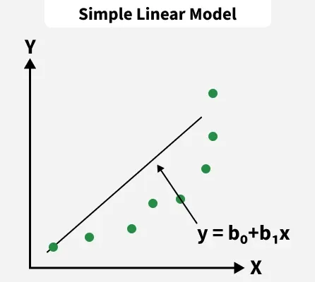
Simple Linear Regression
Linear Regression forms a straight line relationship between independent variables and the target. It is simple, interpretable and used in analytics and forecasting tasks.
Formula: Y=b0+b1X+ϵ Where:
Y is the predicted value or dependent variable
b0 is the intercept, constant value
b1 is the coefficient affecting, slope of the line
X input variable, independent variable, ϵ is the error term.
Example: Suppose: Marks = 30 + 7 × Study Hours
Intercept = 30: predicted marks when StudyHours = 0.
Slope = 7: predicted marks increase by 7 marks for one additional hour of study, within this model.
For 5 hours: predicted marks = 30 + 7(5) = 65.

Slide 11
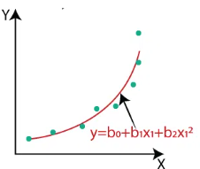
Polynomial Regression
Polynomial Regression is a regression technique used to model a curved relationship between an independent variable \(X\) and dependent variable \(Y\) by including powers of X.
Instead of: Y=b₀+b₁X+ϵ
we can use: Y=b₀+b₁X+b₂X²+ϵ
This is called a second-degree (quadratic) polynomial regression.
A straight-line model assumes a constant rate of change.
But many real-world relationships are curved.
Polynomial regression can capture patterns such as:
U-shaped relationships
Increasing/decreasing curves
Third degree — Cubic Y=b₀+b₁X+b₂X²+b₃X³⁺ϵ
Can represent more complex curves.
Higher degree → greater flexibility, but also greater risk of overfitting.

Slide 12
A quadratic model can be used:
FuelConsumption = b₀+ b₁Speed + b₂(Speed)² + ϵ This allows the relationship to curve.
Understanding the X² Term Suppose our estimated model is:
Fuel = 8 - 0.08 (Speed) + 0.001 (Speed)² FC= 8 - 0.08(Speed)+0.001(Speed)²
8 → intercept
-0.08 → linear effect
0.001 → quadratic effect
Speed² → allows the relationship to curve
The important point is: The X² term allows the effect of X² on Y to change as X changes.
Summary: Polynomial regression extends linear regression by adding powers of the predictor to capture curved relationships between X and Y.

Slide 13
Advantages | Limitations
Captures curved relationships More flexible than simple linear regression Easy to implement Can be estimated using least squares | Higher-degree polynomials can overfit Coefficients can be difficult to interpret individually Polynomial terms may create multicollinearity Predictions outside the observed data range can be unreliable.
Least Squares chooses the regression coefficients so that the sum of squared residuals is as small as possible:
That's why it is called Least Squares. It Chooses the regression equation that minimizes the total squared prediction errors.
Polynomial regression uses least squares to find the coefficients of the polynomial that best fit the observed data.

Slide 14
Role of Least Squares in Regression
To estimate regression coefficients by minimizing the total squared residual error.
e_{i}= Y_{i} - Ỹ_{i} min ∑( e_{i})²
Least Squares helps to:
Estimate regression coefficients
Find the best-fitting regression equation
Minimize prediction errors in the training data
Calculate fitted/predicted values
Form the basis of OLS regression
Least Squares finds the regression model whose sum of squared residuals is minimum.
And OLS (Ordinary Least Squares) simply means applying this least-squares criterion without observation-specific weights.

Slide 15
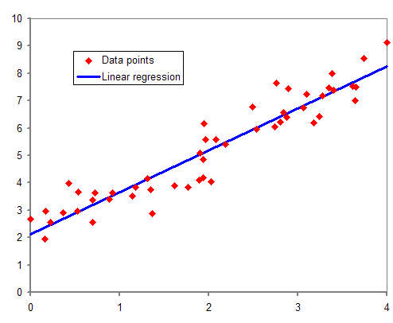
Requirements in Regression Model Building
Building a reliable regression model requires meeting specific data requirements, core statistical assumptions, and preprocessing steps. When these requirements are met, your model produces accurate and unbiased predictions.
Data Requirements & Preprocessing
Continuous Target Variable: Your dependent variable (Y) must be numeric and continuous (like house prices or sales volume).
Feature Preparation: Clean your data by handling missing values, encoding text categories into numbers, and scaling features so large numbers do not overpower smaller ones.
Train-Test Split: Divide your dataset (usually 80% for training and 20% for testing) to evaluate how well the model performs on unseen data.

Slide 16
Core Statistical Assumptions
Linear regression relies on five main assumptions about your data and error terms (residuals):
Linearity: The relationship between independent variables (X) and the dependent variable (Y) must be a straight line.
Independence of Errors: Residuals (prediction errors) must be completely uncorrelated with each other (common in non-time-series data).
Homoscedasticity: The variance of the error terms must be constant across all levels of the predictor variables.
Normality of Residuals: The error terms should follow a normal distribution (bell-curve shape).
No Multicollinearity: Independent variables should not have strong linear correlations with each other
Model Evaluation Metrics
MAE (Mean Absolute Error): Measures the average magnitude of absolute errors.
MSE (Mean Squared Error): Penalizes larger errors more heavily by squaring them.
R-squared (R²): Represents the proportion of variance in the dependent variable explained by your predictors.

Slide 17
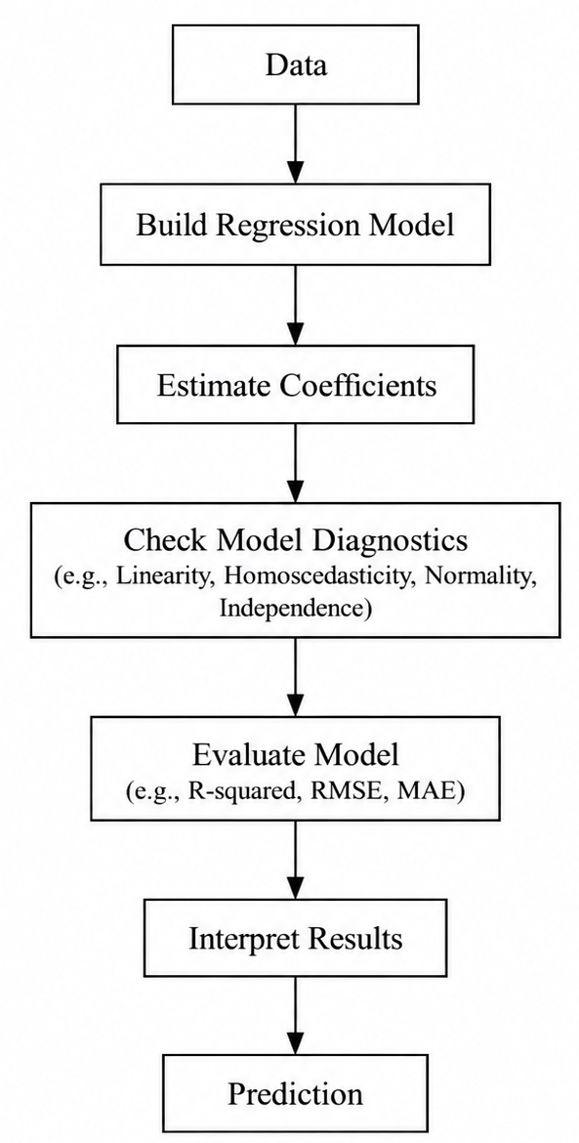
What is Model Diagnostics? Ask - "Is my model behaving properly?"
Model diagnostics is the process of checking whether a fitted regression model is appropriate, reliable, and satisfies the assumptions required for valid interpretation and inference.

Slide 18
Model Building: A Practical Workflow:
1. Define the prediction/problem objective
2. Collect and understand the data
3. Clean and prepare variables
4. Explore relationships and visualize
5. Select/build the regression model
6. Estimate coefficients
7. Diagnose and evaluate the model
8. Interpret results and make predictions

Slide 19
Interpretation of Regression Results for Management Decision
Regression analysis helps managers look at data to predict future results and make smart choices. When you run a regression model in predictive analysis, the numbers tell a story about how different factors affect your business goal
Example: Predicting Final Examination Marks: Study Hours, Attendance (%), Internal Assessment Marks
Suppose the fitted regression model is: Final Marks=20+5(Study Hours)+0.3(Attendance)+0.6(Internal Marks)
Variable | Coefficient | Interpretation
Intercept | 20 | Predicted marks when all predictors are zero
Study Hours | +5 | For every additional hour of study, predicted marks increase by 5 marks, keeping other variables constant
Attendance | +0.3 | A 1% increase in attendance is associated with 0.3 additional predicted marks, keeping other variables constant
Internal marks | +0.6 | Each additional internal mark is associated with 0.6 additional predicted final marks, keeping other variables constant

Slide 20
Example Prediction
For a student with: Study Hours = 6, Attendance = 80%, Internal Marks = 25
Final Marks=20+5(6)+0.3(80)+0.6(25) =20+30+24+15 = 89 Marks.
Interpretation: The model predicts approximately 89 marks for this student.
"Regression converts student-related information into a predicted academic outcome. The coefficients tell us how each predictor is associated with the predicted marks."
From Regression Results to Academic Decision
How can the institution use the results?
Model Measure | Result | Interpretation
R² | 0.78 | 78% of the variation in observed final marks is explained by the predictors in this fitted model
Adjusted R² | 0.75 | Model fit after accounting for the number of predictors
RMSE | 5.2 Marks | Typical prediction error summarized in marks

Slide 21
Model Measure | Result | Interpretation
Study Hour P-value | 0.002 | Statistically significant at 5% level
Attendance P-value | 0.018 | Statistically significant at 5% level
Internal Marks P-value | 0.001 | Statistically significant at 5% level
Interpretation for Management / Academic Decision
1. Identify students who may need support
The model can be used to identify students whose predicted marks are low.
2. Plan academic interventions
The institution may consider:
Additional tutorials, Remedial classes, Mentoring, Attendance monitoring, Additional practice sessions

Slide 22
3. Use predictors as evidence
If study hours, attendance and internal marks show statistically significant associations with final marks, these variables may be useful for identifying students who need attention.
4. Don't treat prediction as certainty
A predicted mark is an estimate, not the student's guaranteed final mark.
Key Message
Regression Output→Interpretation→Academic Insight→Decision
Important: The regression results can support academic decisions; they should not be the sole basis for decisions about individual students.

Slide 23
What is Multiple Regression?
Multiple Regression is an extension of simple linear regression in which two or more independent variables (predictors) are used to predict or explain a dependent variable. The purpose is to examine how multiple factors together are associated with the dependent variable and to generate predictions. Multiple predictors allow the model to incorporate several relevant factors simultaneously.
Y=β0​+β1​X1​+β2​X2​+⋯+βk​Xk​+ϵ
Final Marks=β0 ​+ β1​(StudyHours) + β2​(Attendance) + β3​(InternalMarks) + ϵ
Final Marks = Dependent variable (Y)
Study Hours = Independent variable X1​
Attendance = Independent variable X2
Internal Marks = Independent variable X3

Slide 24
Interpretation of coefficients
Study Hours = 5
One additional hour of study is associated with an estimated 5-mark increase in final marks, holding attendance and internal marks constant.
Attendance = 0.3
A 1% increase in attendance is associated with an estimated 0.3-mark increase in final marks, holding the other predictors constant.
Internal Marks = 0.6
One additional internal mark is associated with an estimated 0.6-mark increase in final marks, holding the other predictors constant.
Key phrase:
"Holding other variables constant"
Based on the fitted regression model, the student's predicted final mark is 89.

Slide 25
Significance of Multiple Regression Analysis
How do we know whether the predictors/model are statistically useful?
Regression output commonly provides:
Coefficient
Standard Error
t-statistic
p-value
R²
Adjusted R²
F-statistic / F-test
Individual Predictor
For a coefficient βj
H0​:βj​=0
H1​:βj​ <>0
If: p<0.05, the coefficient is considered statistically significant at the 5% level.

Slide 26
Predictor | Coefficient | P-value
Study Hours | 5.0 | 0.002
Attendance | 0.3. | 0.018
Internal marks | 0.6 | 0.001
All three predictors have: p<0.05
Therefore, each has statistical evidence of an association with final marks within this fitted model.
One important distinction:
Individual significance: t-test → individual coefficient
"Is there evidence that Study Hours is associated with Marks, given the model?"
Overall significance : F-test → regression model as a whole
"Does the model provide evidence that at least one of the slope coefficients is non-zero?"

Slide 27
Some Important Definition:
Coefficient : What is the effect/association?
Standard Error : How uncertain is the estimate?
t-statistic: How large is the coefficient relative to its uncertainty?
p-value :How strong is the evidence against the null hypothesis?
R²: How much variation does the model explain?
Adjusted R² :Does the model still look good after considering the number of predictors?
F-test : Does the regression model have overall statistical evidence of explanatory power?

Slide 28
Structure of Model Estimation
For multiple regression, we begin with the population model:
Y=β0​+β1​X1​+β2​X2​+⋯+βk​Xk​+ϵ
FinalMarks=β0​+β1​(StudyHours)+β2​(Attendance)+β3​(InternalMarks)+ϵ
The problem is:
We don't know the values of the β coefficients.
We have to estimate them from our sample data.
Why do we need estimation?
Suppose we have data for 100 students:
We want to estimate: β0,β1,β2,β3
so that our model gives predicted marks as close as reasonably possible to the observed marks.
Study Hours | Attenadnce | Internal marks | Final Marks
2 | 65 | 14 | 55
3 | 70 | 18 | 55
….. | … | …. | ….

Slide 29

The fitted model
Suppose estimation gives:
Marks=20+5(StudyHours)+0.3(Attendance)+0.6(InternalMarks)
These numbers: 20,5,0.3,0.6
are estimated coefficients. They were obtained from the sample data.
How are the coefficients estimated? This is where Ordinary Least Squares (OLS) comes in.
For every observation: Residual=Actual−Predicted or: ei=Yi−Y
chooses coefficient estimates that minimize:
This is called the:
Residual Sum of Squares (RSS) or Sum of Squared Errors (SSE) depending on notation.

Slide 30
Why do we square the errors?
Suppose our model makes these errors: +5, -3, +2, -4
If we simply add them: 5−3+2−4=0.It might appear that there is no error!
So we square them: 5² + (-3)² + 2² + (-4)² = 25 + 9 + 4 + 16 = 25 + 9 + 4 + 16 = 54
Now the magnitude of the errors is captured.Therefore OLS tries to find the coefficients that give the smallest possible sum of squared residuals.
Summary: Diagnostics Check whether the fitted model is appropriate and whether important problems are present. Examine residuals and residual plots. Check linearity, unusual observations and error behaviour. For multiple regression, examine multicollinearity. For time-ordered data, autocorrelation may be important.

Slide 31
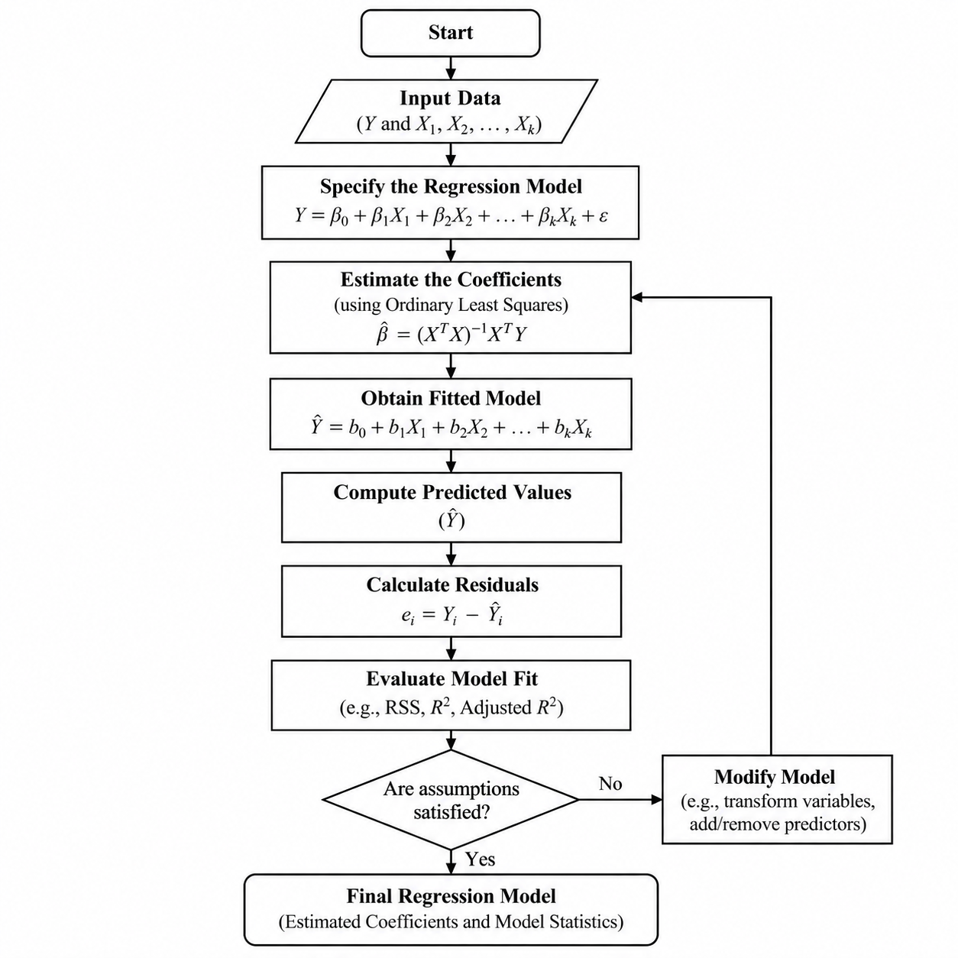
Structure of the Model Estimation:

Slide 32
Testing Rule of Multiple Regression Analysis
What does “Testing Rule” mean?
After we estimate a multiple regression model, we need to determine:
Is each individual predictor statistically significant? - t-test
Is the regression model significant as a whole? - F-test
Example: Student Marks Prediction
Suppose our model is:
Marks = β0 + β1 (StudyHours) + β2 (Attendance)+ β3 (InternalMarks) + ϵ
After estimation, we obtain:
Marks = 20 + 5(StudyHours) + 0.3(Attendance) + 0.6 (InternalMarks)
Now we want to test whether these relationships are statistically significant.

Slide 33
Testing Individual Coefficients — t-test
Suppose we want to test whether Study Hours significantly affects/predicts marks.
Hypotheses
Null hypothesis: Study Hours does not have a statistically significant linear contribution to the model, conditional on the other predictors.
H0: β1=0
Alternative hypothesis: Study Hours has a statistically significant contribution.
H1​:β1​=0
Test statistic: t=B1 / SE(β​1​)

Slide 34
Decision rule: At the 5% significance level:
p-value < 0.05 → Reject H0H_0
p-value ≥ 0.05 → Do not reject H0
Predictor | Coefficient | SE | t | p-value
Study Hours | 5.0 | 1.2 | 4.17 | 0.002
Attendance | 0.3 | 0.1 | 3.00 | 0.018
Internal Marks | 0.6 | 0.015 | 4.00 | 0.001
Since all three p-values are below 0.05, each coefficient has statistically significant evidence in this example.
Important: “statistically significant” does not automatically mean the effect is large or practically important.

Slide 35
2. Testing the Overall Regression Model — F-test
The t-test looks at one predictor at a time. The F-test asks a different question:
Does the regression model as a whole provide statistically significant explanatory information about the dependent variable?
Hypotheses For three predictors: H0​:β1​=β2​=β3​=0
None of the predictors contributes linearly to the model.
Alternative: At least one predictor has a non-zero coefficient.
H1​:At least one βj​=0
Decision rule: Again, using a 5% significance level:
F-test p-value < 0.05 → Reject H0
F-test p-value ≥ 0.05 → Do not reject H0​
For example: F-statistic = 32.5, p-value < 0.001
Therefore, the overall regression model is statistically significant at the 5% level.

Slide 36
t-test vs F-test
Think of a cricket team:
t-test: How do we test whether one particular player is making a statistically detectable contribution?
F-test: How do we test whether the team as a whole provides evidence of contribution?
But remember: a significant F-test does not mean every individual predictor is significant.
Test | What does it test? | Example
t-test | Individual coefficient | Does Study Hours contribute?
F-test | Overall model / group of coefficients | Do the predictors collectively contribute?

Slide 37
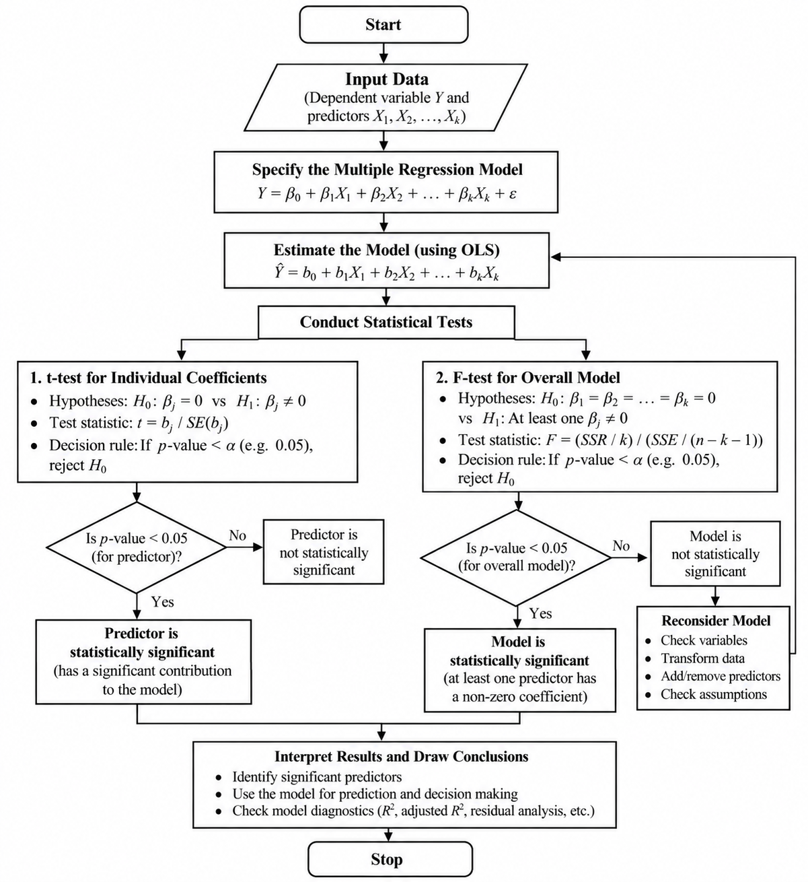

Slide 38
Unit II - Non-Linear Regression Analysis 9Hrs.
Concept: Types of Non-Linear Regression Models - Model Transformation - Difference between Linear and Non-Linear Regression Models.
Diagnostics of Regression Modelling - Model Diagnostics - Multicollinarty - Auto correlation.

Slide 39
What is Non-Linear Regression?
Non-linear regression is a regression technique used when the relationship between the dependent variable (Y) and one or more independent variables (X) cannot be adequately represented by a straight-line relationship.
Simple linear regression
Y = β₀+β₁ X + ϵ
Here, the relationship between X and Y is represented by a straight line.
Non-linear relationship
For example:
Y = β₀+ β₁ X² + ϵ or Y = β₀​e^{β1​X} + ϵ
These can produce curved relationships between X and Y.

Slide 40
Suppose we want to study:
Study Hours → Exam Marks
For a simple linear relationship, we might assume:
Marks=30+5(StudyHours)
This assumes that every additional hour of study produces approximately the same increase in marks. But in reality, the relationship might look like this:
1 → 40 marks
2 → 50
3 → 59
4 → 67
5 → 74
6 → 79
7 → 83
The improvement becomes smaller as study hours increase.

Slide 41
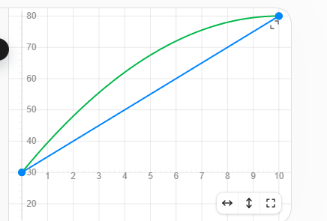
A curved model may represent this better, for example:
Marks=30+10X-0.5X^2, where X = study hours.
y=30+5x ( 0<=x<=10)
y=30+10x-0.5x^2 ( 0<=x<=10)
The straight line represents a linear relationship,
while the curved line represents a non-linear relationship.
Nonlinear regression models are used when the relationship between variables is better represented by a curve rather than a straight line.

Slide 42
Why do we need Non-Linear Regression?
A linear model may not adequately capture patterns such as:
Growth that accelerates
Growth that slows down
Saturation
Diminishing returns
Exponential growth or decay
U-shaped or inverted-U relationships
Example
Study Hours vs Marks
Initially, increasing study hours may substantially improve marks.
But after a certain point, additional study hours may produce smaller improvements.
A curved model can represent this pattern better than a straight line.

Slide 43
Common Types of Non-Linear Models
For your next PPT slide, introduce these:
1. Polynomial Model
Y=β0​+β1​X+β2​X2+ϵ, Used for curved relationships.
Exponential Model: Y=β0eβ1X+ϵ Used for rapid growth or decay.
Logarithmic Model: Y=β0​+β1​ln(X)+ϵ Useful when Y changes rapidly initially and then changes more slowly.
Power Model: Y=β0​Xβ1​+ϵ Useful for relationships involving proportional or scaling effects.
Useful for relationships involving proportional or scaling effects.

Slide 44
Linear vs Non-Linear Regression:
Use linear regression when a straight-line relationship is adequate; use a nonlinear form when the relationship shows systematic curvature that the linear form does not capture.
Feature | Linear Regression | Non-Linear Regression
Relationship | Straight-line form | Curved/nonlinear form
Example | Y=β0​+β1​X | Y=β0​+β1​X2
Pattern | Constant rate of change in basic linear form | Rate of change can vary
Graph | Straight line | Curve
Use | Approximately linear relationships | Curved relationships

Slide 45
Model Diagnostics:
After building a model, we must check whether the model is appropriate and reliable before using its results for prediction or decision-making.
Basic definition: Model diagnostics is the process of checking whether a fitted regression model satisfies the required assumptions and whether there are problems such as unusual observations, non-constant variance, or correlated errors.
The key idea is:
Build Model → Diagnose Model → Validate Model → Interpret/Use Model
Why do we need Model Diagnostics?Suppose we build this model:
Marks=β0+β1StudyHours+β2Attendance+β3InternalMarks+ϵ
The software may give us coefficients, R2R^2, p-values, etc.
But can we immediately trust the model? No.

Slide 46
We need to check whether the model assumptions are reasonably satisfied.
For example:
Is the relationship approximately linear?
Are the errors independent?
Is the variance of errors constant?
Are residuals approximately normally distributed?
Are there unusual/outlier observations?
Are predictors highly correlated with each other?
These checks are called model diagnostics
The Most Important Role: Residual : A residual is the difference between the actual value and the predicted value. ei​=Yi​−Y^i​ . Where:
YiY_i = actual value Actual marks = 80
Y^i\hat{Y}_i = predicted value Predicted marks = 75
eie_i = residual/error for observation i e=80−75=5e=80-75=5

Slide 47
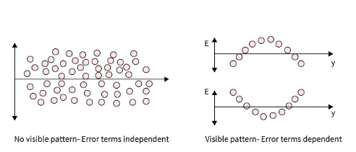
Why are Residuals Important?
A good regression model should leave behind random-looking residuals.
If residuals show a systematic pattern, it indicates that the model may not be capturing something important.
Good residual pattern:Residual::Randomly scattered around zero → generally desirable.
Problematic pattern : A systematic curve/trend → possible model problem.

Slide 48
Main Model Diagnostics
1. Linearity: Is the relationship between predictors and dependent variable appropriately modeled?
2. Homoscedasticity: Is the variance of residuals approximately constant?
3. Normality of Residuals: Are residuals approximately normally distributed?
4. Autocorrelation: Are residuals independent of one another?
5. Outliers and Influential Observations : Are some observations unusually far from the rest or disproportionately affecting the fitted model?
6. Multicollinearity: Are independent variables highly correlated with one another?

Slide 49
Diagnostic 1 — Linearity: Linear regression assumes that the relationship between the predictors and the dependent variable is adequately represented by the specified linear model.
Linearity diagnostics for complex or non-linear predictive setups involve checking whether the modeled relationships or residual behaviors deviate from linear assumptions, or linearizing components to evaluate model fit.
For example: Marks=β0​+β1​StudyHours+ϵ
If the actual relationship is strongly curved, a simple linear model may not be appropriate.
How do we check?
Commonly using: Scatter plot, Residual vs fitted-value plot,Residual plots against predictors
Good indication Residuals show no systematic pattern.

Slide 50
Linearity in Diagnostics
Residual Analysis: Plotting residuals against predicted (fitted) values helps detect hidden non-linear patterns or curvature that a straight-line model misses.
Linear-in-Parameters vs. Functional Linearity: Models like polynomials use transformed features (X², X³) to capture curves while remaining linear in their coefficients.
Partial Residual Plots: Visual tools (like component-plus-residual plots) isolate the linear or non-linear effect of a single predictor variable while holding others constant.
Problem:A clear curve or systematic pattern suggests that the model may be missing nonlinear structure.
Possible Solutions: Transform variables, Add polynomial terms, Consider a nonlinear model

Slide 51
Diagnostic 2 — Homoscedasticity: The variance of residuals remains approximately constant across the range of predicted values or predictors.
For example, residuals should not be: Small spread → → → Very large spread. A funnel-shaped residual plot may indicate heteroscedasticity.
If the variance is not constant, the estimated standard errors and statistical tests can be affected. Heteroscedasticity means that the variance (spread) of prediction errors (residuals) is not constant across all values of an independent variable or predicted value.
Unequal Spread: Errors grow larger or smaller as the predicted values increase or decrease (often showing a fan or cone shape on a graph).
Violated Assumptions: Standard predictive models like Ordinary Least Squares (OLS) assume homoscedasticity—meaning errors have uniform variance everywhere.

Slide 52
Impact on Models: While coefficient estimates remain unbiased, their standard errors become inaccurate. This makes p-values, confidence intervals, and hypothesis tests untrustworthy, lowering model reliability.
How to Detect It
Residual Plots: Plot residuals against predicted values; look for funnel or cone shapes rather than a random, even scatter.
Statistical Tests: Use formal checks like the Breusch-Pagan Test or White Test.
How to Fix It
Data Transformation: Apply a logarithmic or square-root transformation to the dependent variable.
Weighted regression (weighted least squares) is a regression model where each observation is given a certain weight that tells the software how important it should be in the model fit.

Slide 53
Feature | Homoscedasticity | Heteroscedasticity
Variance of residuals | Constant across all X values | Changes across X values
Appearance on scatter plot | Even spread around regression line | Fan-shaped or funnel-shaped spread
Effect on coefficient estimates | Unbiased and efficient | Unbiased but inefficient
Effect on standard errors | Accurate | Biased (inflated or deflated)
Effect on p-values | Valid | Potentially misleading
Common in biomedical data? | Ideal, but not always present | Very common

Slide 54
Formal Statistical Tests:When visual inspection is ambiguous, formal tests provide confirmation:
Interpreting the results.
A significant p-value (typically < 0.05) in these tests indicates heteroscedasticity is present
These tests can be overly sensitive in large samples so always combine with visual inspection
Test | What It Does | Best Used When
Breusch-Pagan Test | Regresses squared residuals on predictors; detects linear heteroscedasticity | General-purpose; widely used
White’s Test | A more general version of Breusch-Pagan; detects non-linear patterns too | Complex models with interactions
Goldfeld-Quandt Test | Splits data in two and compares variances | Variance changes at a known breakpoint
Levene’s Test | Compares variance across groups | ANOVA settings; comparing group variances

Slide 55
There is no single universal solution. The appropriate remedy depends on why heteroscedasticity is occurring.
1. Transform the dependent variable
This is one of the most common approaches.
If the variance increases with the level of YY, we can transform YY.
Common transformations
Log transformation: Y∗=log(Y)
Square-root transformation: Y∗=YY^*=\sqrt{Y}
Sometimes other transformations are appropriate, such as reciprocal transformation.
Instead of: Y=β0+β1X+ϵ we may model: log⁡(Y)=β0+β1X+ϵ
The transformation can reduce the unequal spread of residuals.

Slide 56
2. Weighted Least Squares (WLS)
If we know or can estimate how the error variance changes across observations, we can give different weights to observations.
Ordinary Least Squares: min⁡ ∑ e^{i2}
Weighted Least Squares: min ∑w^{i​} e^{i2}
where w^{i} is the weight assigned to observation ii.
Observations with greater error variance receive less weight, while observations with smaller error variance receive more weight.
This can produce more efficient coefficient estimates when the variance structure is correctly specified.

Slide 57
3. Use Robust Standard Errors
Sometimes we don't want to change the regression coefficients.Instead, we can use heteroscedasticity-robust standard errors.
Keep the estimated regression coefficients, but adjust the standard errors so that statistical inference is more reliable in the presence of heteroscedasticity.
This is particularly useful when the main concern is hypothesis testing and confidence intervals rather than changing the fitted mean relationship.
You may hear these called:
Robust standard errors
Heteroscedasticity-consistent standard errors
Huber–White standard errors

Slide 58
4. Reconsider the Model Specification
Heteroscedasticity can sometimes indicate that the model is missing an important variable or an appropriate functional form.
For example, suppose: Marks=β0​+β1​StudyHours+ϵ
but students' attendance also affects marks.
We could consider: Marks=β0​+β1​StudyHours+β2​Attendance+ϵ
Similarly, a nonlinear relationship might require:
Marks=β0​+β1​StudyHours+β2​StudyHours2+ϵ
So:
Check whether the regression model is correctly specified before simply applying a statistical remedy.

Slide 59
Handling Heteroscedasticity (Summary):
First understand why it occurs; then choose an appropriate remedy.
1. Transform variables Log transformation Square-root transformation Other appropriate transformations | 2. Use Weighted Least Squares (WLS) Assign weights based on error variance Gives less influence to observations with greater error variance
3. Use Robust Standard Errors Regression coefficients can remain unchanged Standard errors are adjusted for heteroscedasticity Useful for more reliable inference | 4. Reconsider Model Specification Add relevant predictors Consider nonlinear terms Check whether the functional form is appropriate

Slide 60
Diagnostic 3 — Normality of Residuals :
Normality of residuals is the assumption that these residuals follow a normal (Gaussian) distribution, typically centered around zero. Intuitively, most errors should be small, large errors should be rare, and the pattern of errors should look roughly symmetric.
In linear regression, normal residuals are not required for the model to produce a line or even for predictions to be reasonable. The big reason we care is inference: normality supports the usual t-tests, F-tests, confidence intervals, and p-values for coefficients—especially in smaller samples. If residuals are strongly non-normal (heavy tails, skew), those uncertainty estimates can be misleading.
How you check it in practice
Q–Q plot: points close to a straight line suggest approximate normality.
Histogram of residuals: a rough bell shape is a good sign.
Formal tests like Shapiro–Wilk (useful, but overreact with large datasets).

Slide 61
For Non-Linear Model:
Normality of residuals in non-linear models is not strictly required for estimating parameters, but it is important for valid statistical inference (such as confidence intervals and p-values).
Why It Matters:
Parameter Estimation: Just like in linear regression, you do not need normal residuals to find the best-fit curve for a non-linear model using methods like Ordinary Least Squares (OLS) or non-linear least squares.
Hypothesis Testing & Inference: P-values, t-statistics, and confidence intervals rely on the assumption that the error terms (and thus the residuals) follow a normal distribution, especially in small sample sizes.
Large Samples: If sample size is large, the Central Limit Theorem helps ensure that confidence intervals and tests remain reasonably valid even if residuals depart from normality.
Predictions: Severe non-normality or skewed error distributions can make prediction intervals unreliable or inaccurate.

Slide 62
How to Check Residuals in Non-Linear Models
Q-Q Plots & Histograms: Plot the observed residuals to see if they follow a roughly symmetric, bell-shaped pattern or a straight line.
A Q-Q plot is particularly useful for assessing departures from normality.
Normality Tests: Software packages (like GraphPad Prism) allow you to run tests like Shapiro-Wilk or Kolmogorov-Smirnov directly on the regression residuals rather than the raw data.
Residuals vs. Fits: Always check for homoscedasticity (constant variance) and non-linear patterns using residual scatter plots, as violations here are often more damaging than minor non-normality.

Slide 63
What is Multicollinearity?
Multicollinearity occurs when two or more independent variables in a regression model are highly related to each other, which destabilizes parameter estimation, inflates standard errors, and makes individual coefficient interpretation difficult.
The problem is that the model then has difficulty separating the individual contribution of each predictor.
Example: Suppose we want to predict: House Prices
using:
X1 = House area in square feet
X2 = Number of bedrooms
X3 = Number of rooms
X4 = Number of bathrooms.
2. Age,Experience, YearTorRetirement
3. Income, expenditure, Standard of leaving

Slide 64
Our model is:
Price=β0​+β1​Area+β2​Bedrooms+β3​Rooms+β4​Bathrooms+ϵ
Notice: As Area increases, the number of Bedrooms and Rooms also increases. Therefore, these predictors contain overlapping information.
For example: Area ↔ Bedrooms, Area ↔ Rooms, Bedrooms ↔ Rooms
This creates multicollinearity.
"If bedrooms and rooms are important
for house prices, why are their
p-values so high?". The answer can be multicollinearity.
The model has difficulty determining: "How much of the price effect should be attributed to Area, how much to Bedrooms, and how much to Rooms?"
because these variables are strongly related.
Predictor | Coefficient | p-value
Area | ₹5,000 | 0.001
Bedrooms | ₹20,000 | 0.62
Rooms | ₹15,000 | 0.71

Slide 65
Impact on Predictive Analysis: Multicollinearity occurs when predictors provide overlapping information, making it difficult for the regression model to estimate the individual contribution of each predictor accurately.
Unstable Estimates: Small changes in the data or starting values lead to wildly fluctuating nonlinear coefficients.
Misleading Inference: P-values can appear non-significant even when a strong relationship exists between the predictors and the response. If predictors are highly correlated, their standard errors can become large, making the individual t-statistics smaller and p-values larger. The model cannot precisely separate its effect from the effects of correlated predictors.
Parameter Estimation: High collinearity can inflate standard errors and undermine the precision of parameter estimates. Standard errors become excessively large, reducing the statistical significance of individual predictors.

Slide 66
Model Interpretation: Correlated predictors make it challenging to discern the individual effect of each variable on the outcome. When predictors move together, it becomes difficult to isolate the individual contribution of each predictor.
Prediction Accuracy: Multicollinearity can lead to overfitting or poor generalization, affecting the model's predictive power. Multicollinearity primarily creates a problem with the stability and precision of coefficient estimates and inference. It does not automatically mean that prediction accuracy will be poor.
Multicollinearity can reduce the stability and generalizability of a model's predictions, particularly when the predictor relationships in new data differ from those in the training data.
Multicollinearity does not necessarily make the entire model useless; its major impact is that it makes individual coefficient estimates less precise and harder to interpret.

Slide 67
Diagnostic Methods:
Correlation Matrix: Check pairwise linear or monotonic correlations.
Area & Bedrooms = 0.85 → strong positive correlation . Diagonal values are always 1.00, because a variable is perfectly correlated with itself, means the predictors are strongly related to each other. So there is a possibility of multicollinearity. Therefore, the model may find it difficult to determine the individual contribution of Area, Bedrooms, and Bathrooms to house price.
 | Area | Bedrooms | Bathrooms
Area | 1.00 | 0.85 | 0.80
Bedrooms | 0.85 | 1.00 | 0.75
Bathrooms | 0.80 | 0.75 | 1.00

Slide 68
Variance Inflation Factor (VIF): Measure how much the variance of a coefficient is inflated; a VIF value above 5 or 10 signals critical multicollinearity. Standard errors become excessively large, reducing the statistical significance of individual predictors.
Tolerance: Calculated as 1 - R² for a predictor regressed on others; values below 0.10 indicate severe collinearity. R-squared (R^2) measures the proportion of variation in the dependent variable that is explained by the fitted regression model.
R² = explanatory power, NOT prediction accuracy. R^2=0.80 → The model explains 80% of the observed variation in Y. R² = explanatory power, NOT prediction accuracy.
Condition Number / Index: Derived from the eigenvalues of the scaled design/ Jacobian matrix; values exceeding 30 suggest severe instability.

Slide 69
Solution to the Multicollinearity:
Mitigation Strategies
Feature Selection: Remove redundant or highly overlapping predictor variables.
Dimensionality Reduction: Apply Principal Component Analysis (PCA) to convert correlated variables into orthogonal features.
Regularization: Use penalized regression techniques adapted for nonlinear or generalized frameworks (such as Ridge or LASSO) to shrink coefficients and stabilize variance.

